Slide 1
Audience: Potential Bidders
Non-Compulsory Briefing Session
TRANSNET REQUEST FOR PROPOSAL [RFP] : HOAC-HO-38187
DESCRIPTION: FOR THE PROVISION OF AN INTEGRATED TRAIN PLANNING PROGRAM SOLUTION FOR A PERIOD OF 3 YEARS AND 6 MONTHS WITH TEN (10) YEAR’S SUBSCRIPTION, AND SME AUGMENTATION AND SUPPORT
Date: 23 MARCH 2023 at 11H00
Via MS TEAMS

Slide 2
AGENDA
Introduction / Welcoming
Safety
Housekeeping and General Rules
Attendance
Allow for completion of the presentation
In the interest of fairness, all questions relating to clarification of this RFP are to be submitted in writing to Madumetja.Mabitsela@transnet.net by the 31 March 2023 at 12:00pm. Answers will be shared with ALL Bidders present at this non-compulsory Briefing Session
After the closing date of the RFP, a Respondent may only communicate with the Prudence Nkabinde, at telephone number 011 584 0821, email Prudence.Nkabinde@transnet.net on any matter relating to its RFP Proposal.
Information will not be repeated for the benefit of Respondents joining late

Slide 3
RFP DESCRIPTION
TRANSNET REQUEST FOR PROPOSAL [RFP] NUMBER : HOAC-HO-38187
FOR THE PROVISION OF AN INTEGRATED TRAIN PLANNING PROGRAM SOLUTION FOR A PERIOD OF 3 YEARS AND 6 MONTHS WITH TEN (10) YEAR’S SUBSCRIPTION, AND SME AUGMENTATION AND SUPPORT
CLOSING DATE : 20 April 2023
CLOSING TIME : 12pm
BID VALIDITY PERIOD : 180 BUSINESS DAYS FROM CLOSING DATE (28 November 2023)

Slide 4
NOTICE TO BIDDERS
SECTION 2 Refer to Page 5/44
This RFP may be downloaded directly from National Treasury’s e-Tender Publication Portal at www.etenders.gov.za.
PROPOSAL SUBMISSION
a) The Transnet e-Tender Submission Portal can be accessed as follows:
▪ Log on to the Transnet eTenders management platform website (https://www.transnet.net);
▪ Click on “TENDERS”; ….
Bidders are required to ensure that electronic bid submissions are done at least a day before the closing date to prevent issues which they may encounter due to their internet speed, bandwidth or the size of the number of uploads they are submitting. Please do not wait for the last hour to submit. A Bidder can upload 30MB per upload and multiple uploads are permitted

Slide 5
MANDATORY DOCUMENTS - DISQUALIFYING
REFER TO PAGE 12/44
MANDATORY RETURNABLE DOCUMENTS
SECTION 1: SBD1 Form ( Refer to page 3/44 in the RFP)
SECTION 4: Pricing Notes ( Refer to page 16/44 in the RFP)
ANNEXURE A: Pricing Schedule
Failure to provide all these Mandatory Returnable Documents at the Closing Date and time of this RFP will result in a Respondent’s disqualification.

Slide 6
DOCUMENTS USED FOR SCORING
Failure to provide all Returnable Documents used for purposes of scoring a bid, by the closing date and time of this bid will not result in a Respondent’s disqualification. However, Bidders will receive an automatic score of zero for the applicable evaluation criterion: Refer to page 22 and 23/44 in the RFP
Failure to provide essential Returnable Documents will result in Transnet affording Respondents a further opportunity to submit by a set deadline. Should a Respondent thereafter fail to submit the requested documents, this may result in a Respondent’s disqualification.

Slide 7
ESSENTIAL RETURNABLE DOCUMENTS & SCHEDULES
Refer to page 24/44 in the RFP
SECTION 5: Proposal Form and List of Returnable documents
SECTION 6: Certificate Of Acquaintance with RFP, Terms & Conditions & Applicable Documents
SECTION 7: RFP Declaration and Breach of Law Form
SECTION 8: RFP Clarification Request Form
SECTION 9: B-BBEE Preference Points Claim Form
SECTION 10: Certificate Of Attendance Of Non-compulsory RFP Briefing
SECTION 11: Job Creation – SECTION 12: SBD5 – SECTION 13: POPIA
Failure to provide essential Returnable Documents will result in Transnet affording Respondents a further opportunity to submit by a set deadline. Should a Respondent thereafter fail to submit the requested documents, this may result in a Respondent’s disqualification.

Slide 8
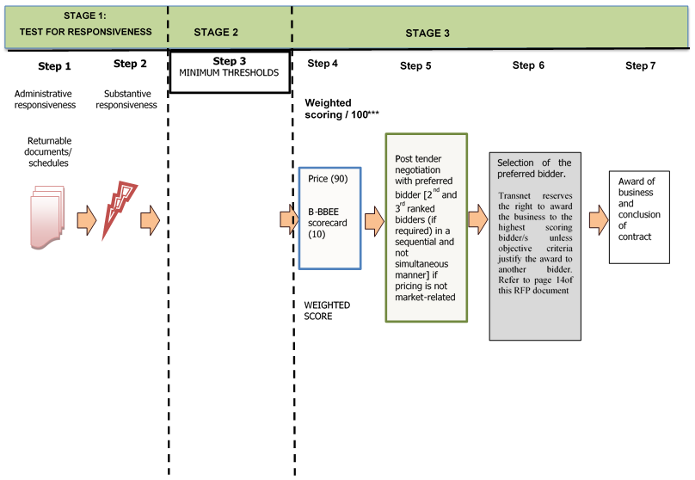
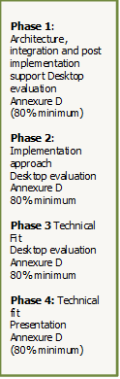
EVALUATION METHODOLOGY
N.B Evaluation of the various stages will normally take place in a sequential manner. However, in order to expedite the process, Transnet reserves the right to conduct the different steps of the evaluation process in parallel. In such instances the evaluation of bidders at any given stage must not be interpreted to mean that bidders have necessarily passed any previous stage(s).

Slide 9
BACKGROUND AND SCOPE OF WORK
TECHNICAL – CURRENT STATUS

Slide 10
Background
In November 2011 TFR adopted the Scheduled Railway operating philosophy. This philosophy requires rail freight to be planned and executed according to a published, balanced, and resourced base train plan for a given production planning period.
Based on a benchmarking exercise against class 1 railways (BNSF, CP and Aurizon), the essence of being a “Scheduled Railway” can be summarised as follows:
A scheduled railway is a planned railway, where we plan the work and work the plan.
Enables the integration of capacity management, demand management and resource planning.
Enables the availability of the published, current version of the integrated, and resourced production plan which instructs all relevant stakeholders what to do, when to do it, who is impacted and what they are impacted by.
Enables the derivation of standardised and appropriate measurements of execution against the integrated production plan. Appropriate performance measures identify areas of continuous improvement and performance optimisation.
The improved quality and stability of the integrated plan results in its reliability, and in the sustainable, adaptable, and resilient adherence to its execution by all stakeholders.

Slide 11
Background
Enables organisational agility by providing information near real time resulting in proactive and timeous planning and quicker focused recovery from deviations.
The availability of high integrity and quality data supporting end to end business processes allow for predictive analytics empowering informed decision making.
Enables accurate measurement and improvement of key performance indicators resulting in increased operational efficiency, improved cycle times & asset utilisation, profitability, customer satisfaction, as well as operational cost reduction.
The ITP programme was established to procure and implement a solution to support the business requirements. The purpose of this document is to provide an overview of the requirements.

Slide 12
Purpose / Objective / Scope
Transnet Freight Rail’s (TFR) strategic objective is to become one of the global top Railway Companies. TFR will require extensive re-engineering of current fragmented and manual processes and the implementation of benchmarked leading rail industry standards and solutions.
This initiative aims to procure a turn-key solution for TFR in the areas of: (a) Capacity Planning, (b) Railway Planning and Simulation, (c) Base Train Planning, (d) Production Planning and (e) Execution Monitoring and Deviation Management, and by so doing re-engineer the way TFR currently operates as described in section 6 below.
TFR wants to implement industry leading practices and processes for all solutions.
All solutions should use the same shared platform, master data, common interfaces and common underlying optimisation techniques.
Enable integration with other enabling TFR business processes and ICT solutions.
Interface with the related processes of other Transnet ODs and other partners / players in the transportation logistics supply chain.
Be able to cater for future scalability to provide services to other Transnet ODs in order to simulate the logistical supply chain.

Slide 13
High Level Processes
Future Demand
Base Train Planning
Short-term customer orders
Current Resource View
Resource Based Train Plan
Production Plan
Execution Monitoring and Deviation Management
Unmet demand trigger capacity planning
Operational Planning
(1 – n days)
Resource Capacity Planning
Current Available Resources
EM&DM
(DOO)
Tactical Planning
(3 – 12 months)
Iterative
Process
Strategic Planning
(1 – 30 years)

Slide 14
High Level Solution Processes View
Rail Infrastructure Configuration
(Micro-/Macro-scopic)
Long Term Planning
Theoretical Slot Capacity Timetable
Operational Slot Capacity Timetable
Master Train Schedule
Blocking Plan
Resource Based Train Plan
Un-resourced Production Plan
Wagon Distribution Plan
Locomotive Distribution Plan
Train Crew Allocation Plan
Resourced Production Plan
Published Production Plan
1 – 14-Day Planning
Wagon Execution Monitoring and Deviation Management
Locomotive Execution Monitoring and Deviation Management
Train Crew Execution Monitoring and Deviation Management
TCO Execution Monitoring and Deviation Management
Traffic Regulator Execution Monitoring and Deviation Management
Assess Impact of Deviation and Re-plan
0 – 24-Hour Planning

Slide 15
High Level Capabilities
High level capabilities required to enable and support the Scheduled Railways Philosophy adopted by TFR to ensure that planning and execution is in line with the published, balanced, and resourced base train plan for a given production planning period.
Railway Planning and Simulation
Capacity Planning
Rolling Stock Capacity Planning
Rail Network Capacity Planning
Train Crew Capacity Planning
Base Train Planning
Production Planning
Operational Slot Capacity
(Rail Network configuration and train configurations)
Master Train Schedule (MTS)
(Mainline and yard constraints)
Production Plan
(Mainline and Yard train plans with allocated resources by name and number (RBTP, Orders and Service Specifications))
Wagon Distribution Plan
(Wagon movement works orders)
Optimal Blocking Plan
Demand allocation to MTS
Resource Based Train Plan (RBTP)
(Mainline and TFR Yard plan with allocated resources type and quantity, and validated service specifications)
Railway Simulation
Train Crew Allocation Plan
(Crew Roster)
Locomotive Distribution Plan
(Locomotive movement works orders)
Execution Monitoring and Deviation Management
Train Crew Execution Monitoring and Deviation Management
Locomotive Execution Monitoring and Deviation Management
Wagon Execution Monitoring and Deviation Management
TCO: Production Plan Execution Monitoring
Traffic Regulator: Production Plan Execution Monitoring
Assess Impact of Deviations (To enable/inform rescheduling requirements)

Slide 16
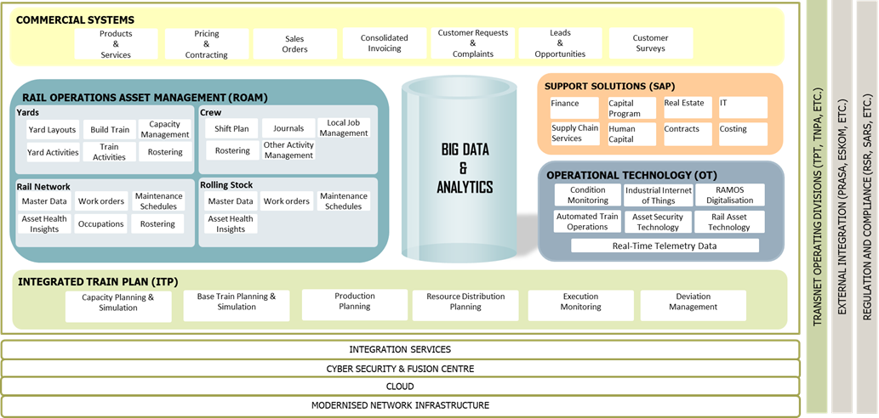
TFR ICT Reference Architecture

Slide 17
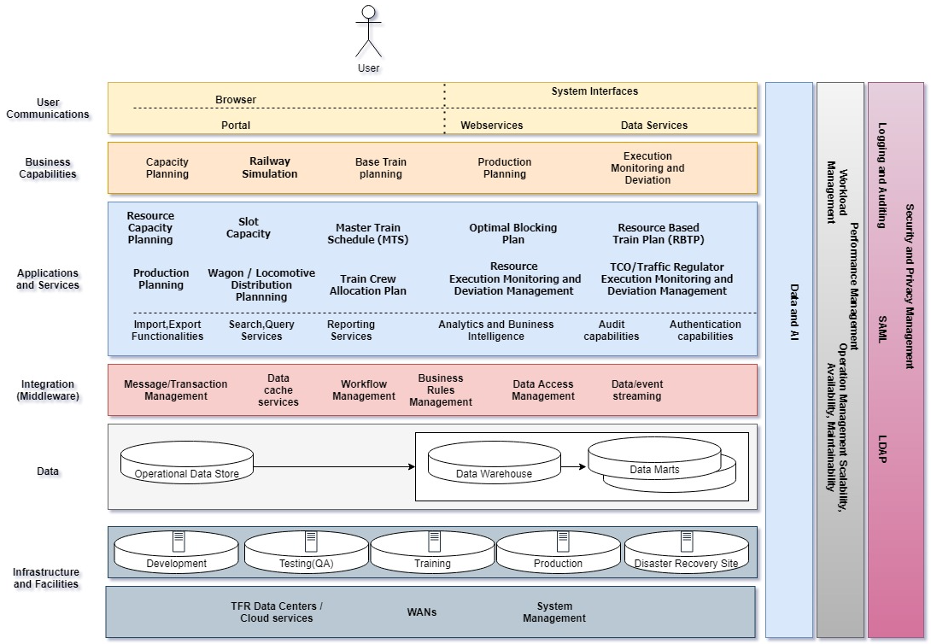
High Level Solution Design

Slide 18
Ledger
Current Solution - Fully Enabled
Current Solutions – Requires Enhancements
Future Solutions
Future Systems Integration View
Customer Portal
Finance
Data and AI
Demand/Order Management
Material Management
Incident Tracking and Management
ITP Programme
Costing
Capacity Planning
Railway Planning and Simulation
Human Capital
Rail Operations and Asset Management
Base Train Planning
Production Planning(PP)
Execution Monitoring and Deviation Management(EMDM)
Train Authorisation/Traffic Management
Internet of things
External systems data set messages
External Systems (Third Party Suppliers, Value Chain Partners, Legislative Bodies, other OD’s…)

Slide 19
Technical Evaluation
The technical evaluation is divided into four (4) phases
Evaluation instructions and scoring are detailed in Annexure D for each phase of the evaluation
Respondents must at least meet a threshold of a phase in order to be evaluated on the next phase
Technical Evaluation Criteria | Thresholds | Reference
Phase 1 - Architecture, integration, and post implementation support Desktop evaluation | 80% | Annexure D
Phase 2 - Implementation approach Desktop evaluation | 80% | Annexure D
Phase 3 Technical Fit Desktop evaluation | 80% | Annexure D
Phase 4: Technical fit Presentation | 80% | Annexure D

Slide 20
Annexure A: Pricing Schedule – Implementation Costs
 | Project resources | Number of resources | Applicable software solution | Rate per hour | Hours required for year 1 | Price for year 1 | Hours required for year 2 | Price for year 2 | Hours required for year 3 | Price for year 3 | Total for 3 years
 | e.g. Project Manager | 1 |  | R800 | 1998 | R1 598 400 | 1998 | R1 598 400 | 1998 | R1 598 400 | R4 795 200
 | Project resources Total |  |  |  |  |  |  |  |  |  | R4 795 200
 | Technical resources | Number of resources | Applicable software solution | Rate per hour | Hours required for year 1 | Price for year 1 | Hours required for year 2 | Price for year 2 | Hours required for year 3 | Price for year 3 | Total for 3 years
 | e.g. Simulation SME | 4 | Simulation tool | R1 200 | 1998 | R9 590 400 | 1998 | R9 590 400 | 1500 | R7 200 000 | R26 380 800
 | Technical resources total
 | Resource Totals |  |  |  |  |  |  |  |  |  | R26 380 800
 | 6 month stabilisation resources
 | Stabilisation resources | Number of resources | Applicable software solution | Rate per hour | Hours required for month 1 | Hours required for month 2 | Hours required for month 3 | Hours required for month 4 | Hours required for month 5 | Hours required for month 6 | Total for 6 months
 | e.g. Project Manager | 1 |  | R800 | 180 | 180 | 180 | 180 | 180 | 180 | R864 000
 |  |  |  |  |  |  |  |  |  |  | R864 000
 | Software subscription during implementation
 | Proposed solution | Cost of license |  | Number of licenses required (including TFR resources) | Year in which licenses will be required | Price for year 1 |  | Price for year 2 |  | Price for year 3 | Total for 3 years
 | e.g. Simulation tool | R3 500 |  | 10 | Year 1 | R35 000 |  | R35 000 |  | R35 000 | R105 000
 | Software subscription totals |  |  |  |  |  |  |  |  |  | R105 000
 | Training Material
 | Proposed solution | Number of user roles | Cost of training material | Year in which training material will be developed |  | Price for year 1 |  | Price for year 2 |  | Price for year 3 | Total for 3 years
 | e.g. Simulation tool | 3 | R2 500 | Year 2 |  | R0 |  | R7 500 |  | R0 | R7 500
 | Training Material totals |  |  |  |  |  |  |  |  |  | R7 500
3 year implementation total |  |  |  |  |  |  |  |  |  |  | R32 152 500

Slide 21
Annexure A: Pricing Schedule – Software Subscription Costs
2 | Sofware subscription for 10 years
Software subscription after implementation
 | Proposed solution | Year | Percentage increase per year | Licence cost per user | License cost per 100 users | Licence cost per 1000 users | Licence cost for 2000 users | Ability to amend licenses on an annual basis e.g. true-up / true-down (Y/N)
 | Solution / Module A | Year 1
 |  | Year 2
 |  | Year 3
 |  | Year 4
 |  | Year 5
 |  | Year 6
 |  | Year 7
 |  | Year 8
 |  | Year 9
 |  | Year 10
Solution A total
 | Solution / Module B | Year 1
 |  | Year 2
 |  | Year 3
 |  | Year 4
 |  | Year 5
 |  | Year 6
 |  | Year 7
 |  | Year 8
 |  | Year 9
 |  | Year 10

Slide 22
Annexure A: Pricing Schedule – SME Augmentation
No | Proposed solution | Number of resources | Hourly cost | Hour requirement per month | Percentage increase from Year n | Total Cost Year 1 | Total Cost Year 2 | Total Cost Year 3 | Total Cost Year 4 | Total Cost Year 5 | Total Cost Year 6 | Total Cost Year 7 | Total Cost Year 8 | Total Cost Year 9 | Total Cost Year 10 | Total Cost
1 |  |  |  |  |  |  |  |  |  |  |  |  |  |  |  | 0
2
3
4
5
SME Augmentation contract total
Annexure_B - Customer reference letter
Annexure_C_Data_Requirements_Matrix
Annexure_D_Evaluation_Criteria

Slide 23
QUESTIONS
Q & A

Slide 24
THANK YOU

